Slide 1
The Importance of Understanding Children’s Lived Experiences
Brett Taylor
EDUC 633
May 27/24

Slide 2
Agenda
Sociocultural Theory
Perceptions of Social Construction & Their Influence
Vygotsky-based Teaching Innovations
The Importance of Understanding Children’s Lived Experiences
Pedagogical Considerations
Questions to Consider
References

Slide 3
Sociocultural Theory
Definition:
Sociocultural theory emphasizes the influence of social interactions and cultural factors on an individual’s development. It highlights how learning, cognitions and psychological processes are shaped by social relationships, cultural norms, and the collective knowledge of a particular society.
Example:
How children learn language through social interactions with their caregivers and the cultural context in which they are raised.
Sociocultural theory explains how cultural norms and beliefs influence individuals’ problem-solving strategies and decision-making process.

Slide 4
Social Construction & Influence
 | Piaget | Vygotsky
Socio-Cultural Context | Little emphasis/relationship | Strong emphasis/relationship
Constructivism | Cognitive Constructivist | Social Constructivist
Stages | Strong emphasis on four developmental stages | No generalized stages & development is continuous
Key Processes | Schemata, Assimilation, Equilibrium, Operation, Conservation | Zone of Proximal Development, Language Acquisition, & Cultural Tools
Role of Language | Has a minimal role: Mind Language | Shapes thoughts: Language Mind
View on Education | Merely refines child’s language and learning. | Plays central role in child’s language development and learning

Slide 5
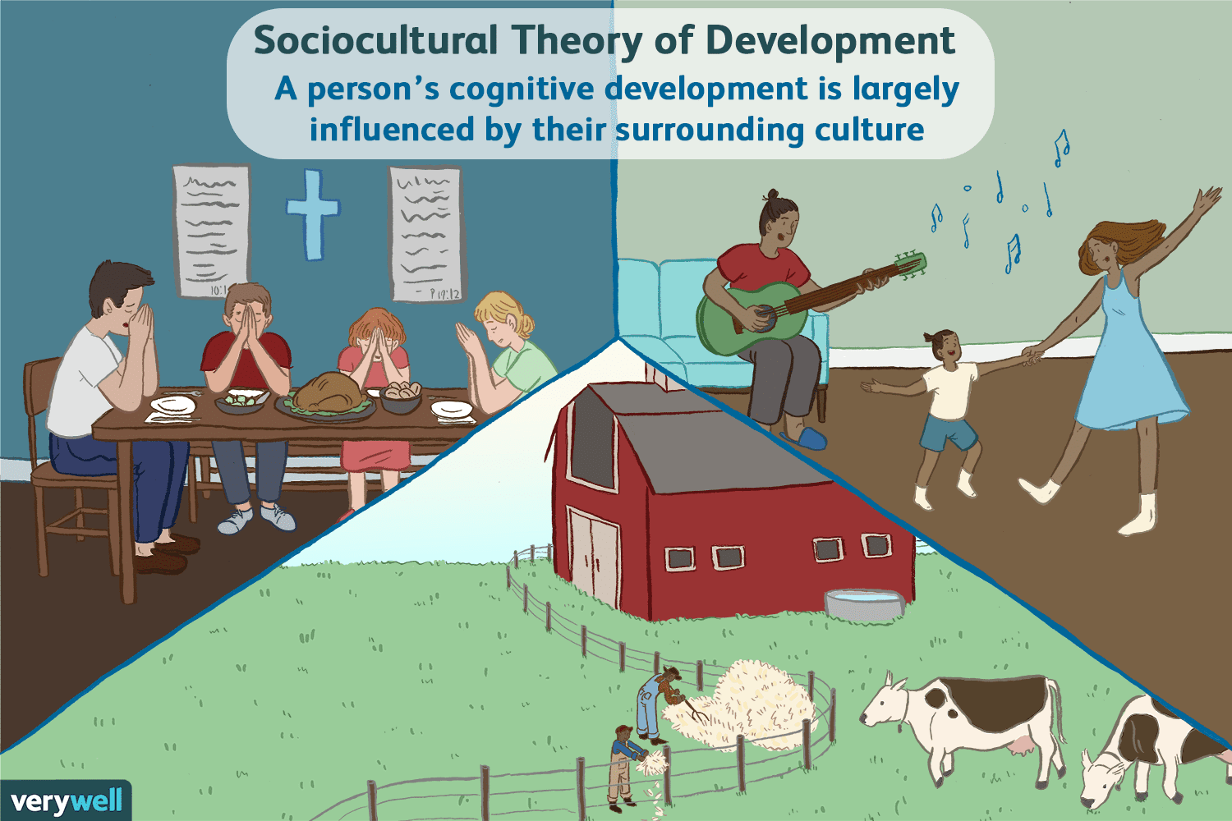

Slide 7
Rogoff et al.
Children’s development occurs within and through everyday experiences, which for children, are cultural experiences.
Learning and development occur in the process of people’s participation in the activities and events of their cultural communities.
To explain development, it is necessary to consider both the kinds of events in which children participate in everyday life and how children develop through their engagement in these events.
“The importance of understanding Children’s lived experience.”
- Barbara Rogoff, audun dahl, & Maureen Callanan

Slide 8
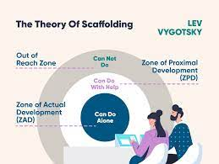
Pedagogical Considerations
We need to recognize how little attention is given to studying children living their lives, in the places that they live their lives.
Middle-class children’s way of life represent one (often unusual) way for childhood to occur.
Implicit and explicit claims about childhood derive from untested intuitions, leaving major debates unsolved and untested.
Treat development as a process of growth in ways of participating in the community, in a process of transformation of participation– Not a process of internalized development.
Recognize that constructs and ‘development stage’ will often appear at different ages in different cultural communities, and sometimes even in the same individual.

Slide 9
Questions to Consider
According to Vygotsky, resilience can be understood as a higher psychological function resulting from an individual’s self-regulatory processes. How effectively can educators instill the concept of resiliency in student’s/learners through cultures of care?
Differentiated learning in modern classrooms is often characterized by increased linguistic and cultural diversity. How can educators avoid unintended homogeneity in language instruction, while simultaneously balancing linguistic distinction and respect for cultural differences?
How dramatically do inherited genetic traits affect Vygotsky’s claim that cognitive development and social interaction are culturally universal?
Vygotsky’s theory of continuous development is often compared directly with Piaget’s developmental stages. Can the two concepts co-exist and complement each other? Or are they too diametrically opposed to work in collaboration?

Slide 10
References
Daniels, H. (2001). Vygotsky and Pedagogy. RoutledgeFalmer.
Holmen, A. (2018) “Additive Language Pedagogy: Aligning a Learner-Centered Approach with Student Diversity.” International Journal of Bias, Identity, and Diversities in Education 3(1), 1-9. https://doi.org/10.4018/IJBIDE.201010101
Newman, S. (2018) “Vugoysky, Wittgenstein and Sociocultural Theory.” Journal for the Theory of Social Behavior, 48(3), 350-368. https://doi.org/10.1111/jtsb.12174
Rogoff, B., Dahl, A., & Callanan, M. (2018) “The Importance of Understanding Children’s Lived Experience.” Developmental Review 50, 5-15. https://doi.org/10.1016/j.dr.2018.05.006

