Slide 1
Achievement Goal Theory
Brett Taylor
230161017

Slide 2
Agenda
Research Context
Philosophical Underpinnings
Introductory Queries
Achievement vs. Goal
Goal Orientations
Target
Takeaways
Future Considerations
References
“Hard-working’ is what gets the job
done. You just see that year after year.
The students who thrive are not
necessarily the ones who come in with
the perfect scores. It’s the ones who love
what they’re doing and go at it
vigorously.”
- Carol S. Dweck

Slide 3
Research Context
Carol Dweck
Stanford University
Martin Maehr
University of Michigan
John Nicholls
University of Illinois-Chicago
Andrew Elliot
University of Rochester

Slide 4
philosophy
ontology
epistemology
AXIOLOGY
Achievement-Goal Theory adheres to a subjectivist reality, where researchers and subsequent participants(including students) are influenced by a wide array of external stimuli around them, including those which are created by their own individual perception of the world around them.
The research and influences surrounding achievement and motivation follow a social constructivist lens that highlights that student beliefs directly influence and predict achievement goal orientations. (Madjar, Weinstock & Kaplan, 2017)
Achievement research recognizes the importance of knowledge and experience, systems of emotions and values, as well as a development of self-awareness and an ability to draw conclusions. (Egamberdieva, 2022)

Slide 5
QUESTIONS TO CONSIDER
Are students more likely to pursue mastery of content or performance-related achievement in their studies?
How do we as educators rank them in terms of importance vs. each other in our daily practice?
How can we promote mastery to students while educational goals and program acceptance are still almost entirely performance-based?

Slide 6
Achievement vs. goal
Competence- a condition or quality of effectiveness, ability, sufficiency or success.
Purpose- the reason for which something is done or created for which something exists.
Aim- end state/result that guides an individual’s behavior.
Reason- underlying motive as to why an individual engages in behavior.
Achievement
Goal
Competence
Purpose
Mastery
Performance
Aim
Reason

Slide 7
Goal orientations
mastery
performance
Focus on mastering a task. (e.g. wanting to understand how a machine works, etc.)
Typically fosters positive emotions, helps develop interest and motivation for learning while encouraging cooperative learning and allowing for deeper cognition. (Pekrun, Elliot, & Maier, 2006)
Focus on outperforming other (e.g. wanting to impress others with their presentation, etc.)
Performance-approach goals can lead to pride, whereas performance-avoidance goals are often related to negative outcomes, such as anxiety, shame and hopelessness. (Pekrun, Elliot & Maier, 2006

Slide 8
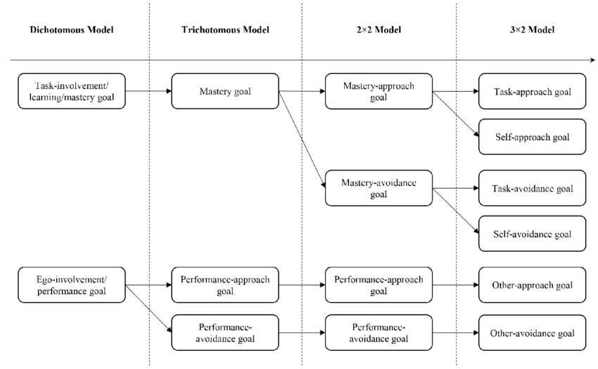
Achievement models
Dichotomous- distinction between mastery goals and performance goals (Dweck, 1986)
Trichotomous-extends the dichotomous model by integrating an approach-avoidance distinction within performance goals (Elliot & Harackiewicz, 1996)
2 x 2 Model- adapts further the trichotomous model to split mastery goals into mastery-approach and mastery avoidance (Elliot & Harackiewicz, 1996)
3 x 2 Model- surrounds competence of task, perceived self- competence and extraneous ‘other’ forces.
Source: Liu, Xiang, Lee, & Li (2017)

Slide 9
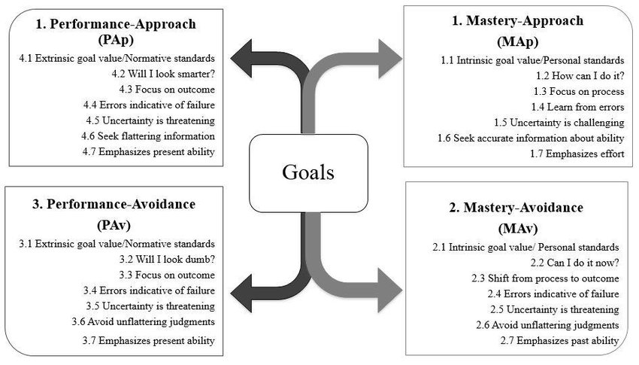
2 X 2 Achievement goal model
Source: Verdin & Morazes (2015)

Slide 10
t.a.r.g.e.t.
Tasks
Design tasks that involve variety and diversity.
Ensure that tasks are interesting and challenging.
Emphasize personal relevance and meaningfulness.
Authority
Allow students choices guided by interest.
Allow students to have a voice in establishing priorities in task completion, method of learning, or pace of learning.
Support students in developing independent thinking and self-regulation.
Recognition
Recognize students’ progress and accomplishments, especially for low-confidence students.
Give positive feedback that focuses on personal improvement & showcase how to grow from this.
Give equal opportunity to receive rewards that focus on efforts, progress, and meaningful aspects of performance.
Grouping
Allow students to work in cooperative learning groups.
Make grouping flexible and heterogeneous.
Evaluation
Evaluate students based on personal progress and individual mastery.
Give students opportunities to regain points by correcting mistakes.
Keep evaluations informative and private between teacher, student, and guardian(s).
Time
Accommodate students’ time needs to learning tasks.
Allow students to schedule timeframes for their improvement.

Slide 11
takeaways
Much like other motivation models, the concept of competence for the learner is paramount, however, it is my belief that the ability to clearly define what competence actually means is difficult due to the numerous variations and models with the achievement goal-theory.
Despite the need for educational assessment to embrace mastery-goals more significantly, “advanced” institutions have been slow to embrace this change, and in doing so have not allowed for mastery-learning to come to the forefront when being compared to performance-based assessments.

Slide 12
Further considerations
How can post-secondary education adapt to the mastery theory as opposed to performance-related assessments? Can it?
Are there fundamental restrictions in place limiting the effectiveness and relevance of content mastery and assessment versus performance-related competition and assessment?
Can performance-related achievement ever be attributed to intrinsic motivation? Or is it always a by-product of extrinsic forces?

Slide 13
REFERENCES
Dweck, C.S. (1986) “Motivational Processes Affect Learning.” American Psychologist 41, 1040-1048.
Elliot, A.J., & Harackiewicz, J.M. (1996) “Approach and Avoidance Achievement Goals & Intrinsic Motivation: A Mediational Analysis.” Journal of Personal and Social Psychology 70, 461-475.
Elliot, A.J., & Hulleman, C.S. (2017) “Achievement Goals.” In Elliot, A.J., Dweck,C.S., Yeager, D.S. (Eds.), Handbook of Competence and Motivation: Theory and Application (pp. 43-60). Guilford Publications.
Egamberdieva, T.A., & Saydulleva, A.R. (2022) “The Importance of Axiological approach in Forming The Cognitive Competence of Future Teachers.” Journal of Positive School Psychology 6(10), 2009-15.
Liu, J., Xiang, P., Lee, J., Li, W. (2017) “Developing Physically Literacy in K-12 Physical Education Through Achievement Goal Theory.” Journal of Teaching in Physical Education 36, 292-302. https://doi.org/10.1123/jtpe.2017-0030

Slide 14
References
Madjar,N., Weinstock, M., & Kaplan, A. (2017) “Epistemic Beliefs and Achievement Goal Orientations: Relations Between Constructs Versus Personal Profiles.” The Journal of Educational Research 110(1), 32-49. https://www.jstororg/stable/26586698
Pekrun, R., Elliot, A.J., & Maier, M.A. (2006). “Achievement Goals and Discrete Achievement Emotions: A Theoretical Model and Prospective Test.” Journal of Educational Psychology 98(3), 583-597. https://doi.org/10.1037/0022-0663.98.5.583
Verdin, D.G., Morazes, J. A. (2015) “Qualitative Study of First-Generation Latinas: Understanding Motivation for Choosing and Persisting in Engineering.” [Paper Presentation]. ASEE Annual Conference and Exposition, Seattle, WA.
Urdan, T., Kaplan, A. (2020) “The Origins, Evolution and Future Directions of Achievement Goal Theory.” Contemporary Educational Psychology 61, 1-10. https://doi.org/10.1016/j.cedpsych.2020.101862

Slide 15
Thank you
Brett Taylor
ctaylor2@unbc.ca
230161017

